Slide 1


Slide 2
Data Overview
Objective: KPIs
Table of Contents
Introduction & Problem Statement
Conclusion
Analysis
Recommendations & Insights

Slide 3
Introduction to Zomato
Founded in 2008, Zomato is a global food delivery and restaurant discovery platform headquartered in India. It connects users with a vast network of restaurants and eateries through its app and website. Offering services like online ordering, table reservations, and reviews, Zomato enhances the dining experience. Operating in multiple countries, it empowers food enthusiasts to explore diverse culinary options. Through strategic partnerships and advanced technology, Zomato makes dining more accessible and enjoyable for millions of users worldwide.

Slide 4
Problem Statement
Geographical Insights
Examine the number of restaurant openings by year, quarter, and month to identify trends and peak periods of growth
Customer Experience Metrics
Temporal Trends
Determine the number of restaurants in each city and country to understand market density and potential growth areas
Categorize restaurants based on average ratings and analyze the distribution to assess service quality across locations
Pricing Analysis
Determine how many restaurants fall within each range to identify affordability levels
Service Features
Calculate the percentage of restaurants offering table bookings and online delivery to evaluate the adoption of customer-centric services
Culinary and Location Insights
Determine the popular cuisines based on location to understand regional preferences and tailor offerings accordingly

Slide 5
Data Overview
Zomato Data Set
15 Countries
141 Cities
9551 Restaurants
1825 Cuisine Served
2.89 Average Rating
1498K Votes
The dataset comprises detailed information about restaurants across multiple countries, with a total of 22 attributes spanning aspects such as location, cuisine, pricing, ratings, and service features. The data is organized into four sheets: the Main sheet provides core restaurant details, including average cost for two, availability of table booking, and online delivery; the Country sheet maps country codes to their respective names; the Currency sheet lists local currencies with their conversion rates to USD; and the Date sheet offers a temporal dimension for analysis.
The dataset includes records of restaurants opened between 2010 and 2018, providing insights into trends over nearly a decade. It covers diverse cuisines, city-level distributions, and customer experience metrics, making it ideal for insights into restaurant trends, regional preferences, and service offerings. Overall, it provides a robust foundation for exploring patterns, identifying opportunities, and making data-driven decisions.

Slide 6
Objective
Cost Standardization
Geographical Analysis
Restaurant Opening Trend
Customer Feedback
Pricing Strategy
Service Offerings
Analyse Regional Cuisine Preferences

Slide 7
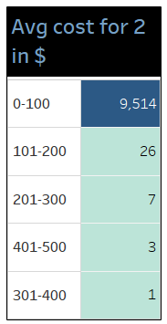
KPI:Average Meal Price in (USD)
The table illustrates the average cost for two people in dollars across 15 countries and 141 cities.
Costs are categorized into buckets of $100 each to simplify the analysis.
A significant 9,514 restaurants fall within the $0–$100 bucket, representing approximately 99% of the total dataset of 9,551 restaurants.
Out of 9551 restaurants, 8,652 restaurants are located in India, where the exchange rate is 1 USD = 83 INR, contributing significantly to the $0–$100 bucket due to the currency conversion effect.
Furthermore, within India, 7,531 restaurants have an average cost for two of $12 or less, further solidifying their position in the $0–$100 bucket.
This highlights that the majority of restaurants in the dataset offer affordable dining options, especially in regions with lower exchange rates.
Buckets above $100 account for a very small proportion, showcasing a limited number of high-end restaurants in the dataset.
The trend underscores the dominance of budget-friendly dining establishments, particularly in countries like India, where the cost of dining is relatively low.

Slide 8
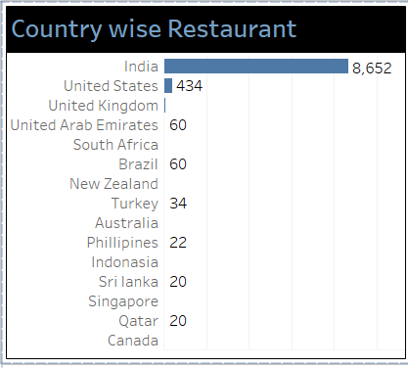
KPI: Restaurants based on City & country
The bar chart represents Zomato's tie-ups across 15 countries and 141 cities, covering a total of 9,551 restaurants.
Out of these, 8,652 restaurants are located in India, accounting for approximately 91% of Zomato's partnerships. This indicates that the majority of Zomato's tie-ups are concentrated in India.
Within India:
5,473 restaurants are located in New Delhi, making it the largest market.
1,118 restaurants are in Gurgaon, highlighting its significance as a key city for partnerships.
The United States ranks second, with 434 restaurants tied up across 35 states, resulting in an average of 12 restaurants per city.
This data highlights the need to expand partnerships internationally and also diversify further within India to capture more markets outside major hubs like New Delhi and Gurgaon.

Slide 9
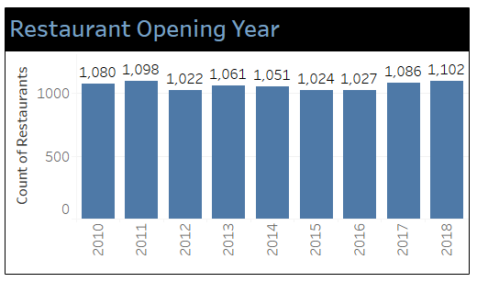
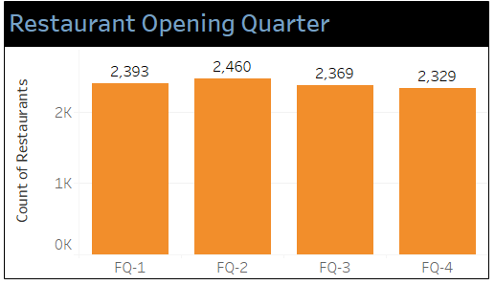
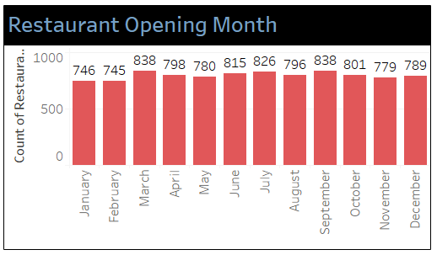
KPI: Restaurants opening based on Year , Quarter , Month
The bar charts represent the number of restaurants opened on a yearly, quarterly, and monthly basis.
Yearly Analysis:
On average, 1,061 restaurants were opened each year from 2010 to 2018.
Comparing 2017 to 2018, there was a 1% growth, indicating the need for more aggressive expansion strategies to achieve higher growth rates.
Quarterly Analysis:
On average, 2,387 restaurants were opened per quarter, indicating consistent growth across the year.
Monthly Analysis:
The average number of restaurants opened each month is 795, reflecting a steady trend of new openings throughout the year.

Slide 10
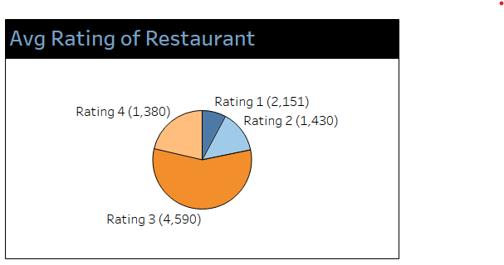
KPI: Restaurants based on Average Ratings
The pie chart represents the average ratings received from customers, reflecting the overall quality of food offered by the restaurants.
Approximately 38% (3,581 restaurants) have a rating of 2 or below, signalling a significant quality concern.
Around 48% (4,590 restaurants) fall under the 3-star rating, indicating that customers find the food acceptable but not exceptional, requiring improvement.
Only 14% (1,380 restaurants) have achieved the highest rating (4 stars), highlighting a need to raise quality standards across the board.
Country-Wise Insights:
Countries with Average Ratings Above 4:
Philippines, Turkey, Indonesia, New Zealand, United Arab Emirates, South Africa, United Kingdom, Qatar, and the United States.
These ratings indicate good food quality in these regions.
Countries with Average Ratings Around 3:
Sri Lanka, Brazil, Australia, Singapore, and Canada.
These ratings suggest moderate quality, requiring slight improvement.
India's Average Rating:
At 2.7, India's average rating is significantly low, highlighting an urgent need for quality enhancement in this region.

Slide 11
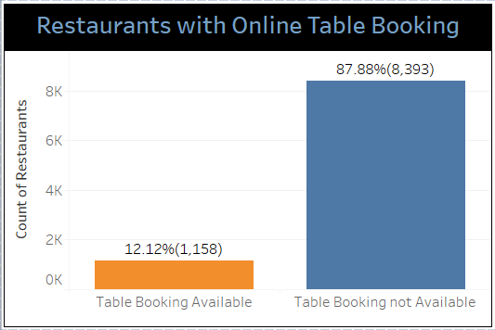
KPI: Restaurants based on Table Booking
The bar chart illustrates the availability of online table booking services across various countries and cities, highlighting significant gaps and opportunities for improvement.
Global Insights:
Approximately 87% of restaurants globally do not offer online table booking services, signalling a major gap in customer convenience.
Countries Without Table Booking Availability: Countries like Australia, Brazil, Canada, Indonesia, New Zealand, Singapore, Sri Lanka, Turkey, and the United States lack this feature, likely due to cultural preferences for pre-booking via traditional methods.
Countries Offering Table Booking Services:
Philippines leads with 64% (14 out of 22 restaurants).
United Arab Emirates follows with 30%, and other countries include::
United Kingdom: 15%.
India: 13%.
Qatar: 5%.
South Africa: 3%.
Analysis for India: In India, the availability of online table booking services varies significantly across cities:
New Delhi: Out of 5,473 restaurants, only 13% offer online table booking services, reflecting a substantial gap that needs immediate attention.
Mumbai: Performs better, with 45% of its restaurants (9 out of 20) providing online table booking services, showcasing a more progressive adoption of modern booking solutions.

Slide 12
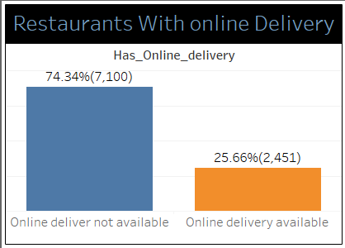
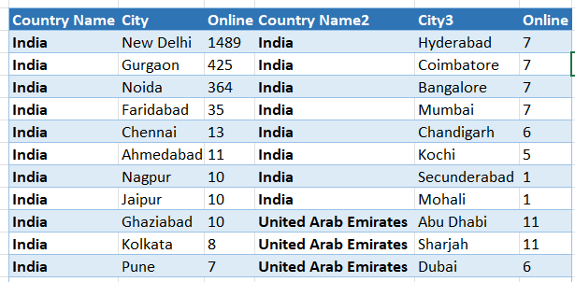
KPI: Restaurants based on Online Delivery
The bar chart illustrates the availability of online delivery services among the restaurants. Key insights include:
74.34% (7,100 restaurants) do not offer online delivery.
Only 25.55% (2,451 restaurants) provide online delivery services.
Global Insights:
Countries like Australia, Philippines, Indonesia, Sri Lanka, Singapore, Qatar, Canada, United States, United Kingdom, Brazil, South Africa, New Zealand, and Turkey lack the online delivery feature.
Only India and the United Arab Emirates offer online delivery services among the analysed countries.
For the United Arab Emirates, the average online delivery rate is 47%, highlighting better adoption compared to global averages.
Analysis for India:
Out of 43 cities, only 19 cities (less than 50%) offer online delivery services.
City-Wise Insights:
New Delhi leads with 27% of its restaurants (1,489 out of 5,473) providing online delivery.
In cities like Ahmedabad, Nagpur, and Jaipur, the online delivery rate is approximately 50%, indicating a growing focus on satisfying customer needs through digital options.
Cities like Kolkata, Pune, Hyderabad, Coimbatore, Bangalore, Mumbai, Chandigarh, and Ghaziabad have an average online delivery rate of 37%, reflecting room for improvement.

Slide 13
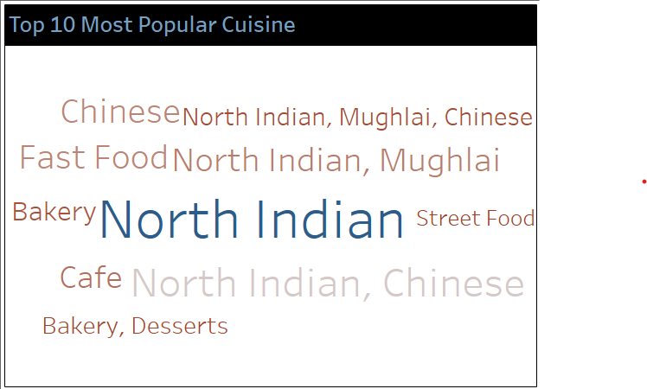
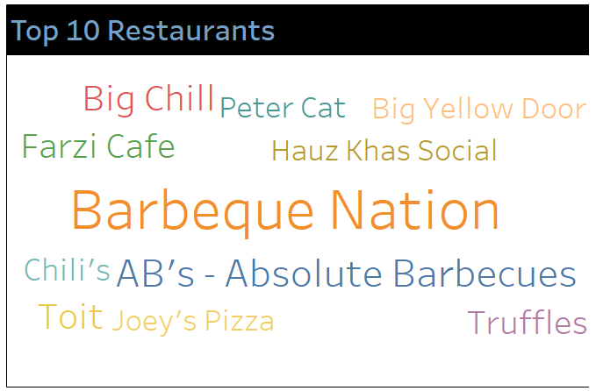
KPI: Top 10 Popular Cuisine and Restaurants
The chart highlights the most popular cuisines globally, with North Indian cuisine being the top favourite, served worldwide.
Chinese cuisine follows closely, reflecting its global appeal.
Fast Food is also a popular choice, catering to a wide customer base.
The chart highlights the most popular Restaurants globally based on votes.
Barbeque Nation leads the list with an impressive 28,142 votes, reflecting its strong customer preference and popularity.
AB's - Absolute Barbecues follows as the second most popular restaurant with 13,400 votes, further emphasizing the widespread appeal of barbecue dining.
Toit, a favourite for its craft beers and ambiance, secures the third position with 10,934 votes
Big Chill, known for its delectable desserts and Italian cuisine, closely follows with 10,853 votes.
The popularity of these restaurants highlights the significance of their unique offerings and customer-focused service.

Slide 14
Overall Analysis
Out of 9,551 restaurants, 91% (8,652) are located in India, with New Delhi hosting the highest number of restaurants (5,473). The United States ranks second with 434 restaurants across 35 cities, averaging 12 restaurants per city.
Approximately 99% of restaurants (9,489) fall under the $0–$100 bucket due to affordable dining options and currency conversion. In India, 7,531 restaurants have an average cost for two under or equal to $12
Around 38% of restaurants have a rating of 2 or below, indicating the need for quality improvement, especially in India, where the average rating is 2.7. Only 14% of restaurants achieve the highest rating of 4 or above, with the Philippines and Turkey leading this metric.
87% of restaurants lack online table booking, with offline preferences in countries like Australia and the United States. In India, only 13% of restaurants, including 5,473 in New Delhi, offer this feature
Only 25.55% of restaurants (2,451) provide online delivery, a feature limited to India and the UAE. In India, just 19 of 43 cities offer online delivery, with New Delhi leading at 27% coverage.
An average of 1,061 restaurants opened per year between 2010 and 2018, with marginal growth of 1% in 2018, highlighting the need for accelerated expansion. Quarter-wise, an average of 2,387 restaurants opened per quarter
An average of 1,061 restaurants opened per year between 2010 and 2018, with marginal growth of 1% in 2018, highlighting the need for accelerated expansion. Quarter-wise, an average of 2,387 restaurants opened per quarter.
North Indian cuisine is the most popular globally, served in 936 restaurants, followed by Chinese (836) and Fast Food (354). Expanding these cuisines in new locations can increase revenue.
Barbeque Nation leads with 28,142 votes, followed by AB’s - Absolute Barbecues (13,400), reflecting customer preference for barbecue. Replicating these models with online delivery and table booking can enhance customer satisfaction

Slide 15
Recommendations and Insights-1
Identify untapped cities and regions with high growth potential and open new branches, both domestically and internationally. Prioritize markets that show the most promise based on customer demand and cuisine popularity.
Leverage Popular Cuisines
Enhance Health-Conscious Menus
Introduce healthier menu options across all restaurant categories to cater to the growing demand for nutritious and sustainable dining choices, offering low-calorie, organic, or plant-based alternatives.
Adapt Menu for Local Preferences
Focus on expanding North Indian and Chinese cuisines, especially in underpenetrated regions. Introduce fusion concepts to create excitement and attract a wider customer base.
Customize menus to cater to local tastes in international markets, ensuring that the cuisine resonates with local consumers while maintaining core brand identity.
Integrate Online Delivery Services
Invest in improving delivery systems and infrastructure to ensure fast, reliable, and efficient service, especially in high-demand regions, to meet customer expectations.
Online Table Booking Services
Implement online table booking services across locations, particularly in high-traffic areas, to improve customer convenience and capitalize on demand for reservations.
Tool Used for Analysis
For the said project, Excel was utilized as the primary tool to analyse the data and derive valuable insights.
Expand Geographic Presence

Slide 16
Recommendations and Insights-2
Invest in User-Friendly Technology
Ensure seamless customer experience by investing in user-friendly online ordering and booking platforms. Make it easy for customers to access services via websites or mobile apps.
Expand Successful Restaurant Models
Monitor and Improve Food Quality
Regularly monitor food quality across locations, ensuring consistency in taste, presentation, and hygiene standards to maintain customer satisfaction and trust.
Create Unique Dining Experiences
Scale successful restaurant models, such as Barbeque Nation, AB's - Absolute Barbecues, Toit, and Big Chill, by opening new locations or franchises in high-demand markets.
Host exclusive events such as chef’s special nights, themed dinners, or live cooking shows to engage customers and create memorable experiences that build brand loyalty.
Focus on Customer-Service
Invest in staff training programs to ensure exceptional customer service at every touchpoint. Regularly update training to focus on customer-centric service excellence.
Develop Customer Loyalty Programs
Implement Seasonal Menus or Promotions
Introduce seasonal menus or holiday-themed promotions to attract customers during key times of the year, capitalizing on festive dining trends and special occasions.
Create loyalty programs that reward frequent diners with discounts, special offers, or exclusive experiences, to increase repeat visits and customer retention.

Slide 17
Recommendations and Insights-3
Launch Targeted Marketing Campaigns
Run targeted marketing campaigns on social media, local events, and through influencers to promote unique offerings and drive footfall to your restaurants. Tailor messages to different customer segments.
Increase Focus on International Markets
Create Premium Offerings to Differentiate
Expand into high-growth international markets, tailoring the restaurant experience to local preferences while introducing popular Indian and Chinese cuisines that have already proven successful.
Offer premium dining experiences, such as exclusive menu items, VIP tables, or special dishes, to cater to high-end clients and differentiate the brand in the competitive market.
Capitalize on Customer Feedback
Set up a robust feedback system to regularly collect customer insights. Use feedback to improve service quality, update menus, and enhance overall customer experience, ensuring long-term satisfaction.
Improve Restaurant Ratings
Actively encourage customer reviews and ratings by offering incentives or discounts to customers who provide feedback
Respond promptly and professionally to negative reviews, demonstrating commitment to improvement and customer satisfaction.
Expand Menu Variety
Offer a wider variety of menu items, including premium, exclusive options, to appeal to different customer segments and enhance the dining experience.

Slide 18
Conclusion
In conclusion, the analysis conducted using Excel provided valuable insights into the restaurant industry, identifying key areas for improvement such as enhancing digital services, improving food quality, and expanding successful restaurant models. By leveraging data-driven recommendations, restaurants can address gaps, increase customer satisfaction, and expand their market reach. The findings underscore the importance of adapting to changing customer needs and continuously optimizing operational strategies for sustained growth and success

Slide 19
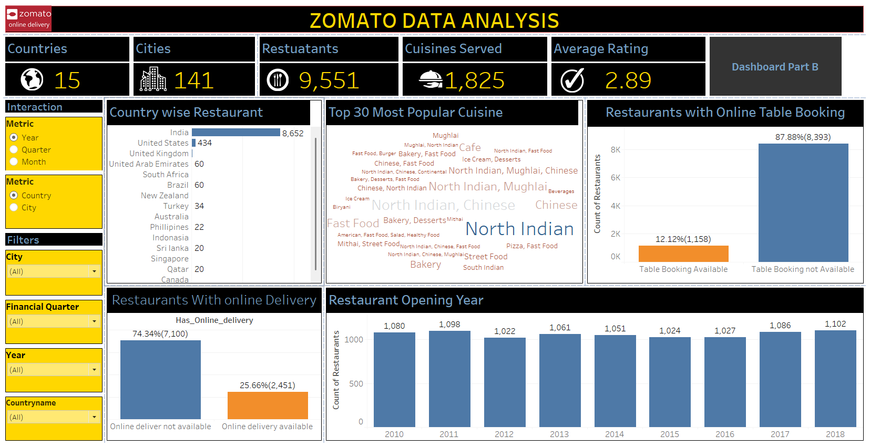
Tableau Dashboard for Zomato Data set-Part A

Slide 20
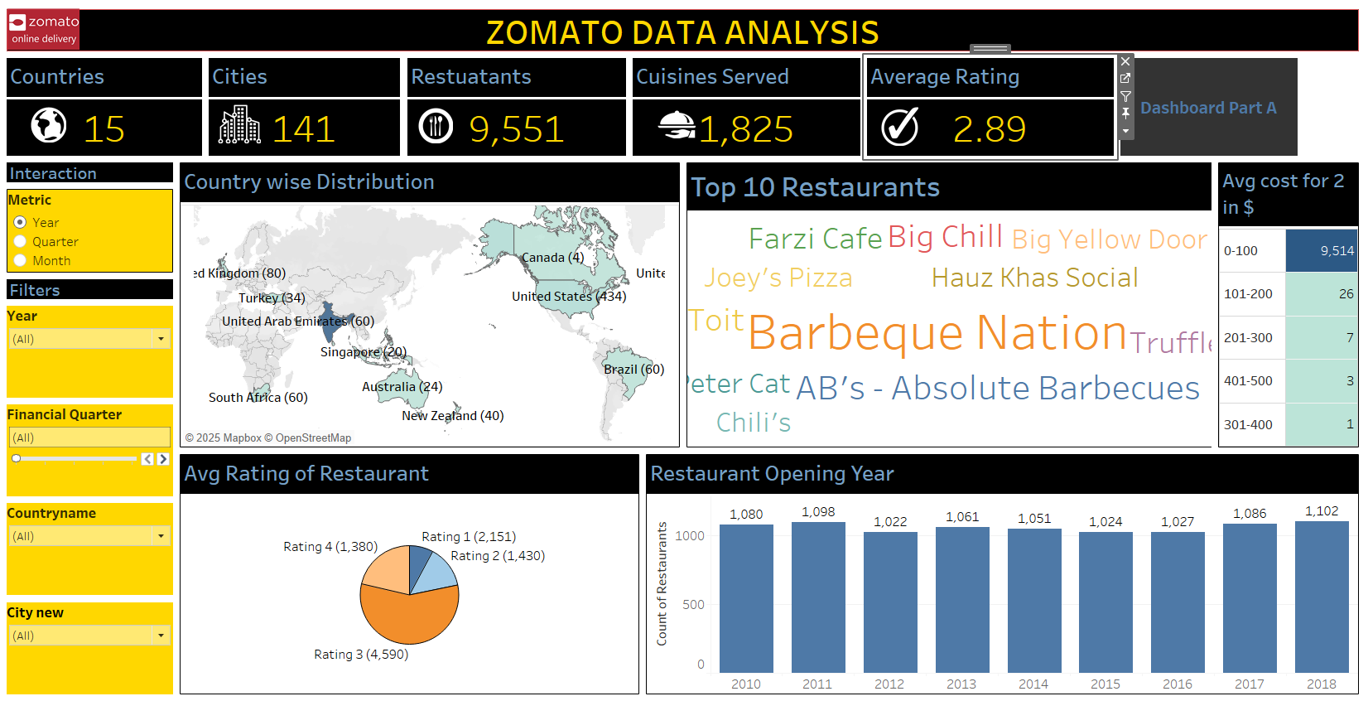
Tableau Dashboard for Zomato Data set-Part B

Slide 21
